Slide 1
Chapter 4 Computer Software
James A. O'Brien, and George Marakas. Management Information Systems with MISource 2007, 8th ed. Boston, MA: McGraw-Hill, Inc., 2007. ISBN: 13 9780073323091

Slide 2
Learning Objectives
Describe several important trends occurring in computer software
Give examples of several major types of application and system software
Explain the purpose of several popular software packages for end user productivity and collaborative computing
Define and describe the functions of an operating system
Describe the main uses of computer programming software, tools, and languages
Chapter 4 Computer Software

Slide 3
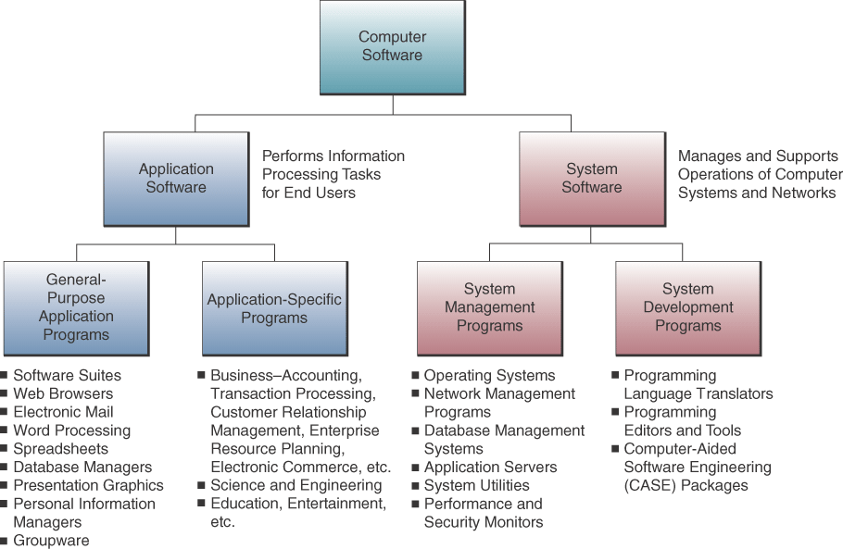
Types of Application & System Software
Chapter 4 Computer Software

Slide 4
Application Software
General Purpose
  Programs that perform common information processing jobs for end users; e.g., word processing, spreadsheet
  Also call productivity packages
Custom Software
  Software applications developed within an organization for use by that organization
Commercial Off-the-Shelf (COTS)
  Many copies sold
  Minimal changes beyond scheduled upgrades
  Purchasers have no control over specifications, schedule, or evolution, and no access to source code or internal documentation
  Product vendor retains the intellectual property rights of the software
Chapter 4 Computer Software

Slide 5
Application Software
Open-source Software
  Developers collaborate on the development of an application using programming standards which allow anyone to contribute to the software
  As each developer completes a project, the application code becomes available and free to anyone who wants it
Chapter 4 Computer Software

Slide 6
Business Application Software
Function-Specific Application Software
  Thousands of these packages support specific applications of end users
  Examples: customer relationship management, enterprise resource planning, supply chain management, Web-enabled electronic commerce
Chapter 4 Computer Software

Slide 7
Software Suites
Most widely used productivity packages are bundled together as software suites
Advantages
  Cost less than buying individual packages
  All have similar GUI
  Work well together
Disadvantages
  All features not used
  Takes a lot of disk space (bloatware)
Chapter 4 Computer Software

Slide 8
Web Browsers
Software applications that support navigation through the point-and-click hyper-linked resources of the Web
Becoming the universal platform from which end users launch…
  Information searches
  E-mail
  Multimedia file transfer
  Discussion groups
  Other Internet-based applications
Chapter 4 Computer Software

Slide 9
Search Engines
Browsers are used to gain access to Internet search engines
  Google, Yahoo!
Using search engines to find information has become an indispensable part of Internet, intranet, and extranet applications
Chapter 4 Computer Software

Slide 10
E-mail, Instant Messaging, and Weblogs
E-mail
  Software to communicate by sending and receiving messages and attachments via the Internet, intranet, or extranet
Instant messaging (IM)
  Receive electronic messages instantly
Weblog or blog
  A personal website in dated log format
  Updated with new information about a subject or range of subjects
Chapter 4 Computer Software

Slide 11
Word Processing/Desktop Publishing
Word Processing
  Create, edit, revise, and print documents
  Example: Microsoft Word, Lotus WordPro, Corel WordPerfect
Desktop Publishing
  Produce printed materials that look professionally published
  Example: Adobe PageMaker, Microsoft Publisher, QuarkXPress
Chapter 4 Computer Software

Slide 12
Electronic Spreadsheets
Used by virtually every business for…
  Analysis, planning, modeling
Electronic Spreadsheet
  Worksheet of rows and columns
  Can be stored on local computer or on network
  Requires designing format and developing the relationships (formulas)
  Most help you develop charts and graphic displays of spreadsheet results
  Supports what-if questions
Chapter 4 Computer Software

Slide 13
Presentation Graphics
Common presentation graphics packages…
  Converts numeric data into graphics displays
  Used to create multimedia presentations of graphics, photos, animation, and video clips
  E.g., Microsoft PowerPoint, Lotus Freelance
  Top packages can tailor files for transfer in HTML format to websites
Chapter 4 Computer Software

Slide 14
Personal Information Managers
Software for end user productivity and collaboration
  Stores information about clients
  Manages schedules, appointments, tasks
  Most include ability to access the Web and provide e-mail capabilities
  Some support team collaboration by sharing information with other PIM users
  Example: Lotus Organizer, Microsoft Outlook
Chapter 4 Computer Software

Slide 15
Groupware
Software that helps workgroups collaborate on group activities
  E-mail, discussion groups, databases, video conferencing
  Example: Lotus Notes, Novell GroupWise, Microsoft Exchange
  Windows SharePoint Services and WebSphere both allow teams to create websites for information sharing and document collaboration
Chapter 4 Computer Software

Slide 16
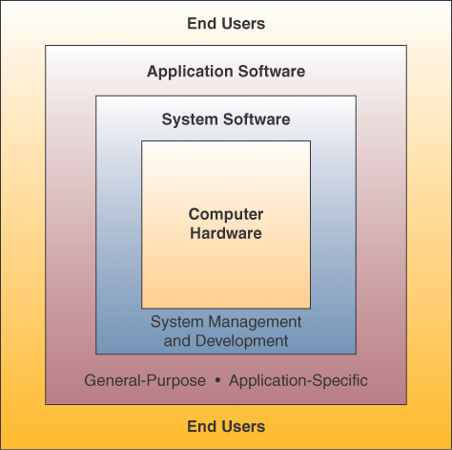
Interface Between End Users and Computer
Chapter 4 Computer Software

Slide 17
Operating Systems
Integrated system of programs that…
  Manages the operations of the CPU
  Controls the input/output, storage resources,
  and activities of the computer system
  Provides support services as the computer executes application programs
The operating system must be loaded and activated before other tasks can be accomplished
Chapter 4 Computer Software

Slide 18
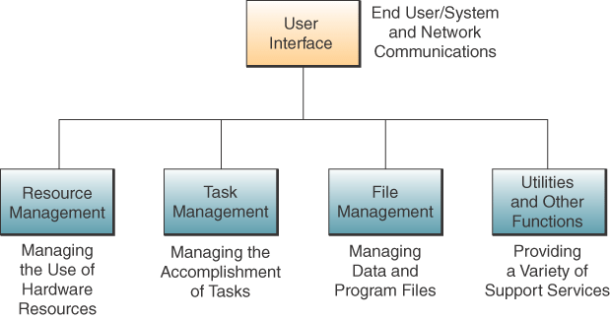
Operating System Basic Functions
Chapter 4 Computer Software

Slide 19
User Interface
The part of the operating system that allows you to communicate with it
Three main types…
  Command-driven
  Menu-driven
  Graphical user interfaces (GUI)
Chapter 4 Computer Software

Slide 20
Resource Management
Part of the operating system that manages the hardware and networking resources of a computer system
  Includes CPU, memory, secondary storage devices, telecommunications, and input/output peripherals
Chapter 4 Computer Software

Slide 21
File Management
Part of the operating system that controls the creation, deletion, and access of files and programs
  Keeps track of physical location on storage devices
  Maintains directories of information about the location and characteristics of stored files
Chapter 4 Computer Software

Slide 22
Task Management
Part of the operating system that manages the accomplishment of end user computing tasks
  Controls which task gets access to the CPU,
  and for how long
  Can interrupt the CPU at any time to substitute a higher priority task
  Supports preemptive and cooperative multi-tasking and multi-processing
Chapter 4 Computer Software

Slide 23
Popular Operating Systems
Windows
  GUI, multitasking, networking, multimedia
  Microsoft’s operating system
  NT, XP, 2003, 2007, 2010
  Different versions manage servers
Unix
  Multitasking, multi-user, network-managing
  Portable - can run on mainframes, midrange,
  and PCs
Linux
  Low-cost, powerful reliable Unix-like
  operating system
  Open-source
MAC OS X
  Apple operating system for the iMac
  GUI
  Multitasking
  Multimedia
Chapter 4 Computer Software

Slide 24
Other System Software
Utilities
  Miscellaneous housekeeping functions
  Example: Norton utilities includes data backup, virus protection, data compression, etc.
Performance Monitors
  Programs that monitor and adjust computer system to keep them running efficiently
Security Monitors
  Monitor and control use of computer systems
  to prevent unauthorized use of resources
Chapter 4 Computer Software

